Slide 1
US National Disaster
By Varun Rao

Slide 2
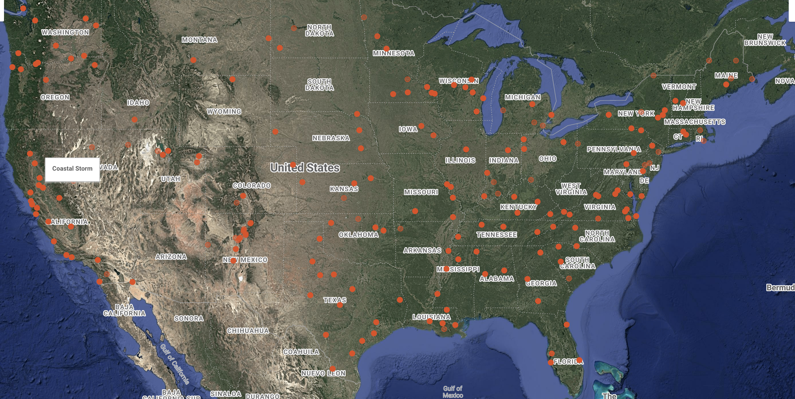
Introduction
The dataset that I have chosen to work with is the based on the National calamity seen across the US. The primary objective using this dataset is to understand which state is the most affected state when it comes to different natural disaster. The data discloses various column such as state (i.e. the state which was impacted by the calamity), incident type (i.e. what is the name of the calamity, example – Tornado, Tsunami), designated area (i.e. which part of the state was affected) and so on.

Slide 3
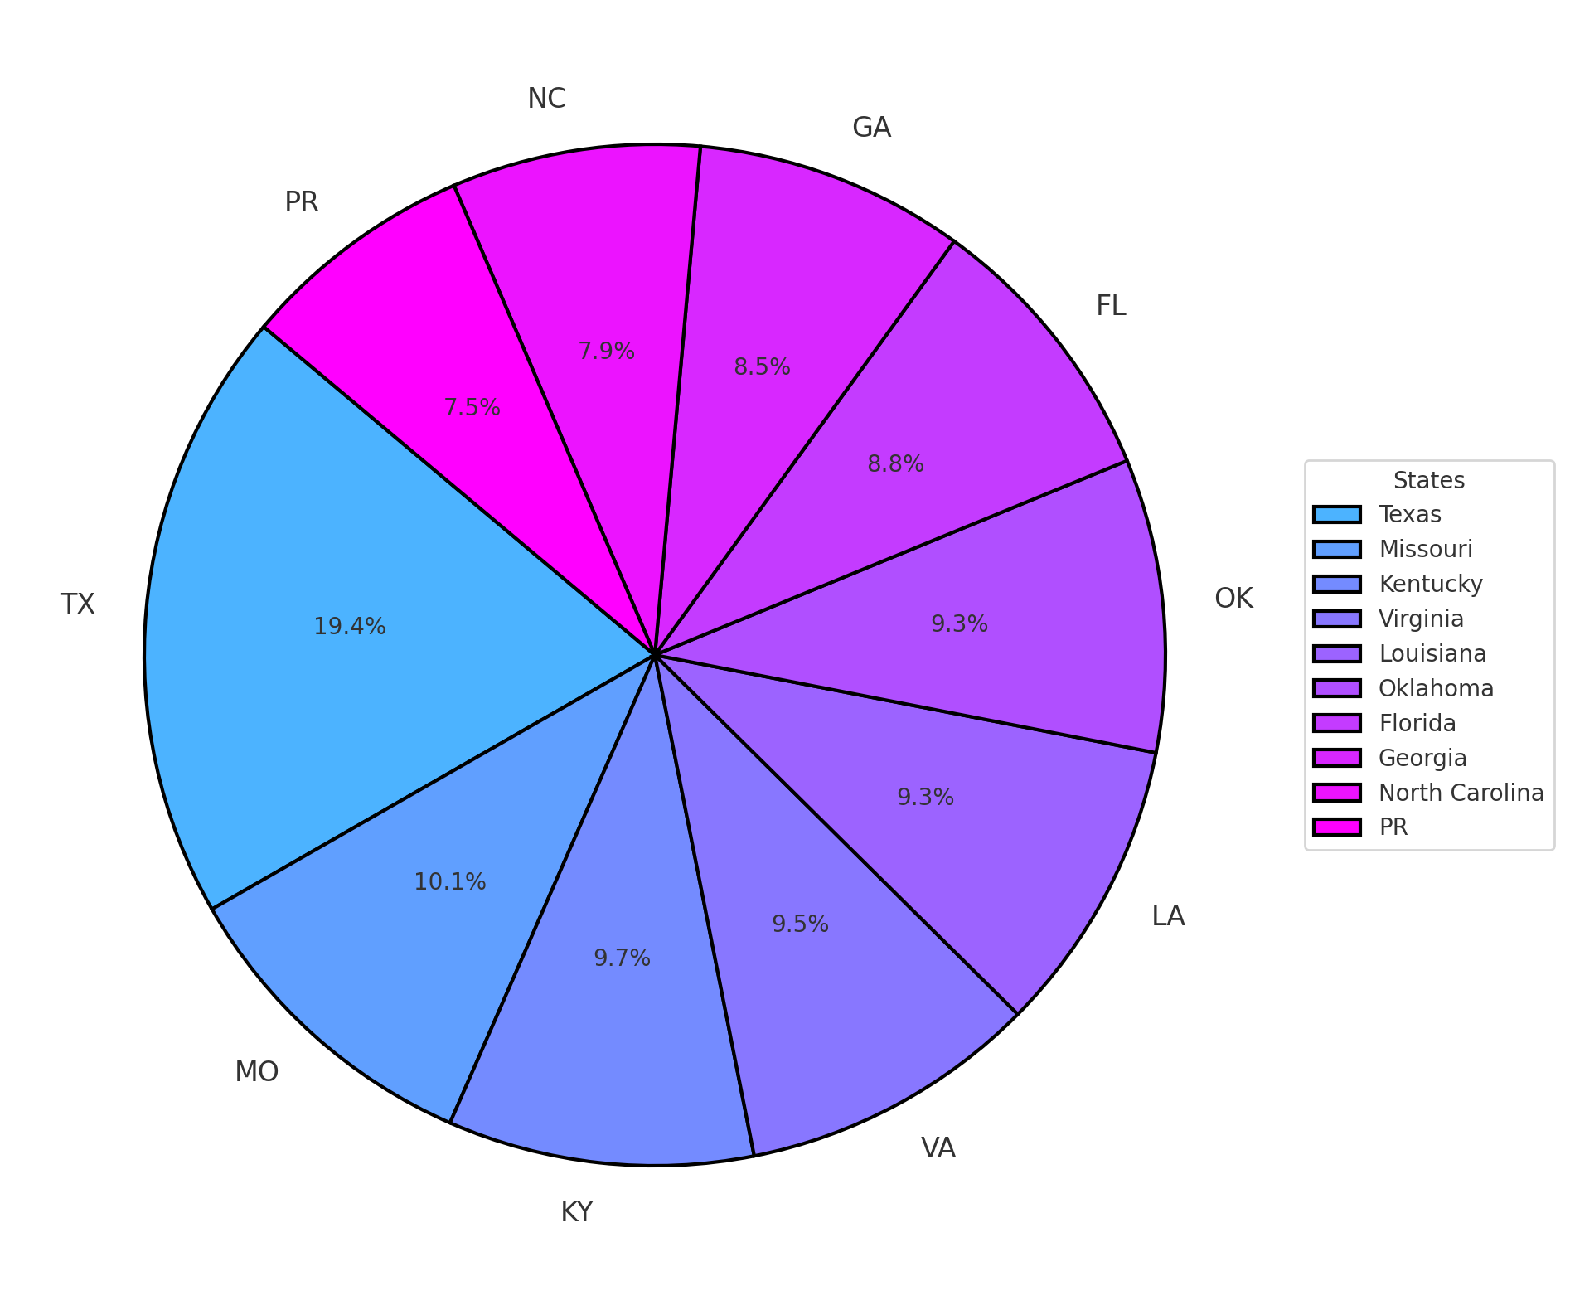
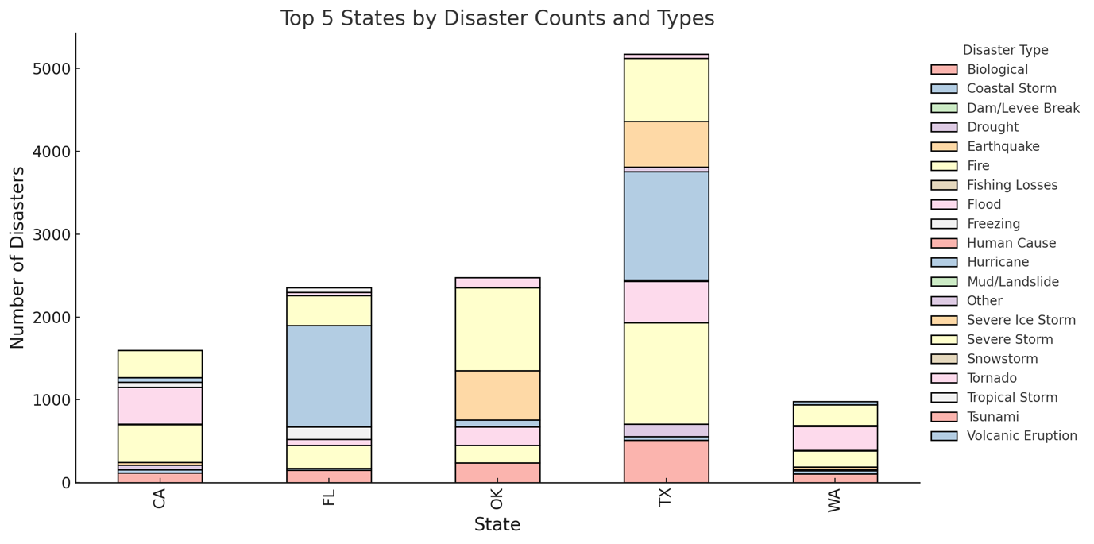
Question 01: Which designated areas are most prone to disasters, and what types of disasters are most common there?
Based on the analysis of the pie chart (Fig. 1), it is evident that Texas is the most disaster-prone region, accounting for approximately 19.4% of the total disasters recorded over the past seven decades. Missouri follows as the second most disaster-affected state, contributing 10.1% to the overall disaster occurrences.
The stacked bar chart (Fig. 2) further highlights Texas as the state most severely impacted by disasters. The primary cause of these disasters is fires, which are closely followed by severe storms in terms of frequency. Approximately 250 fire-related disasters have been reported in Texas, according to the dataset.
Fig.1
Fig.2

Slide 4
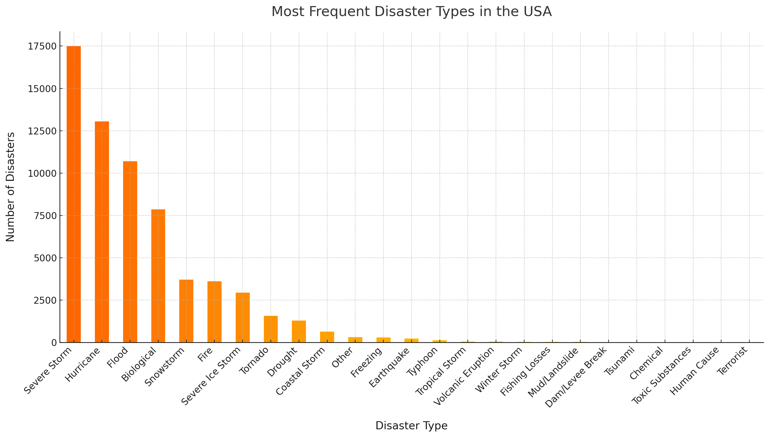
Question 02: Which Disaster_Type categories are most likely to receive FEMA declarations faster?
Based on the analysis presented in Fig. 3, it is clear that Severe Storm disasters have the highest likelihood of receiving a FEMA declaration in the shortest amount of time. The data indicates that approximately 17,500 severe storm-related disasters occurred in the United States between 1953 and 2023. This suggests that Severe Storms are the most common type of disaster to prompt a swift FEMA response.
Fig.3

Slide 5
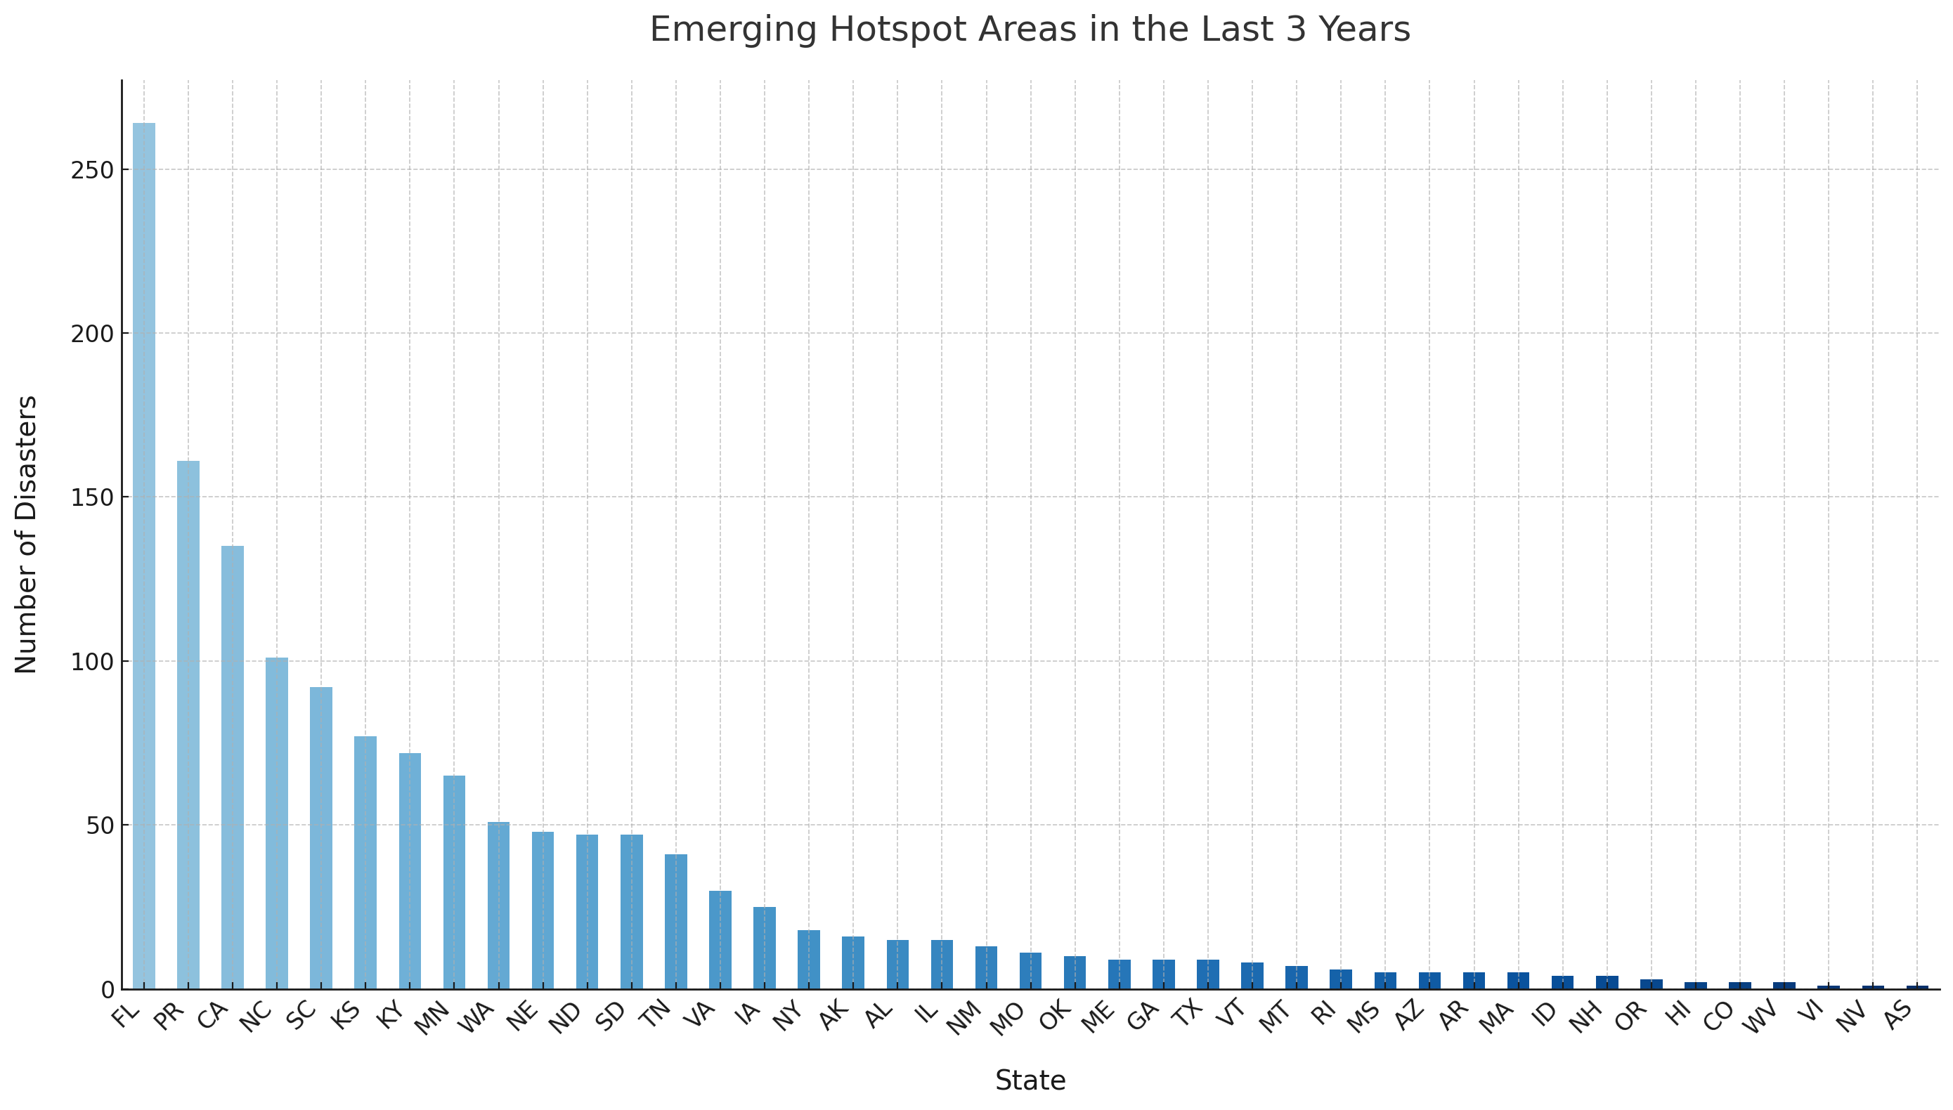
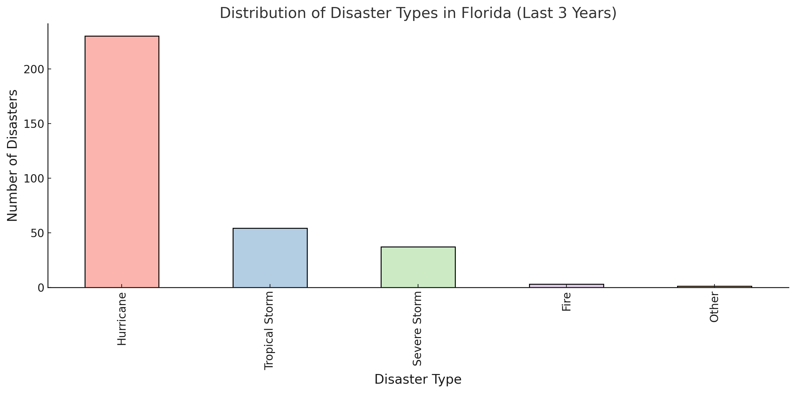
Question 03: What are the emerging hotspots for disasters, based on recent spikes in in previously less-affected areas?
Recently, several states have experienced significant increases in disaster events, with one of the most notable spikes occurring in Florida. As depicted in Fig. 4, Florida has seen over 250 disaster events in the past three years alone.
Further analysis in Fig. 5 reveals that more than 200 of these disasters were related to Hurricanes, followed by a substantial number of events classified as Tropical Storms and Severe Storms.
Fig.4
Fig.5

Slide 6
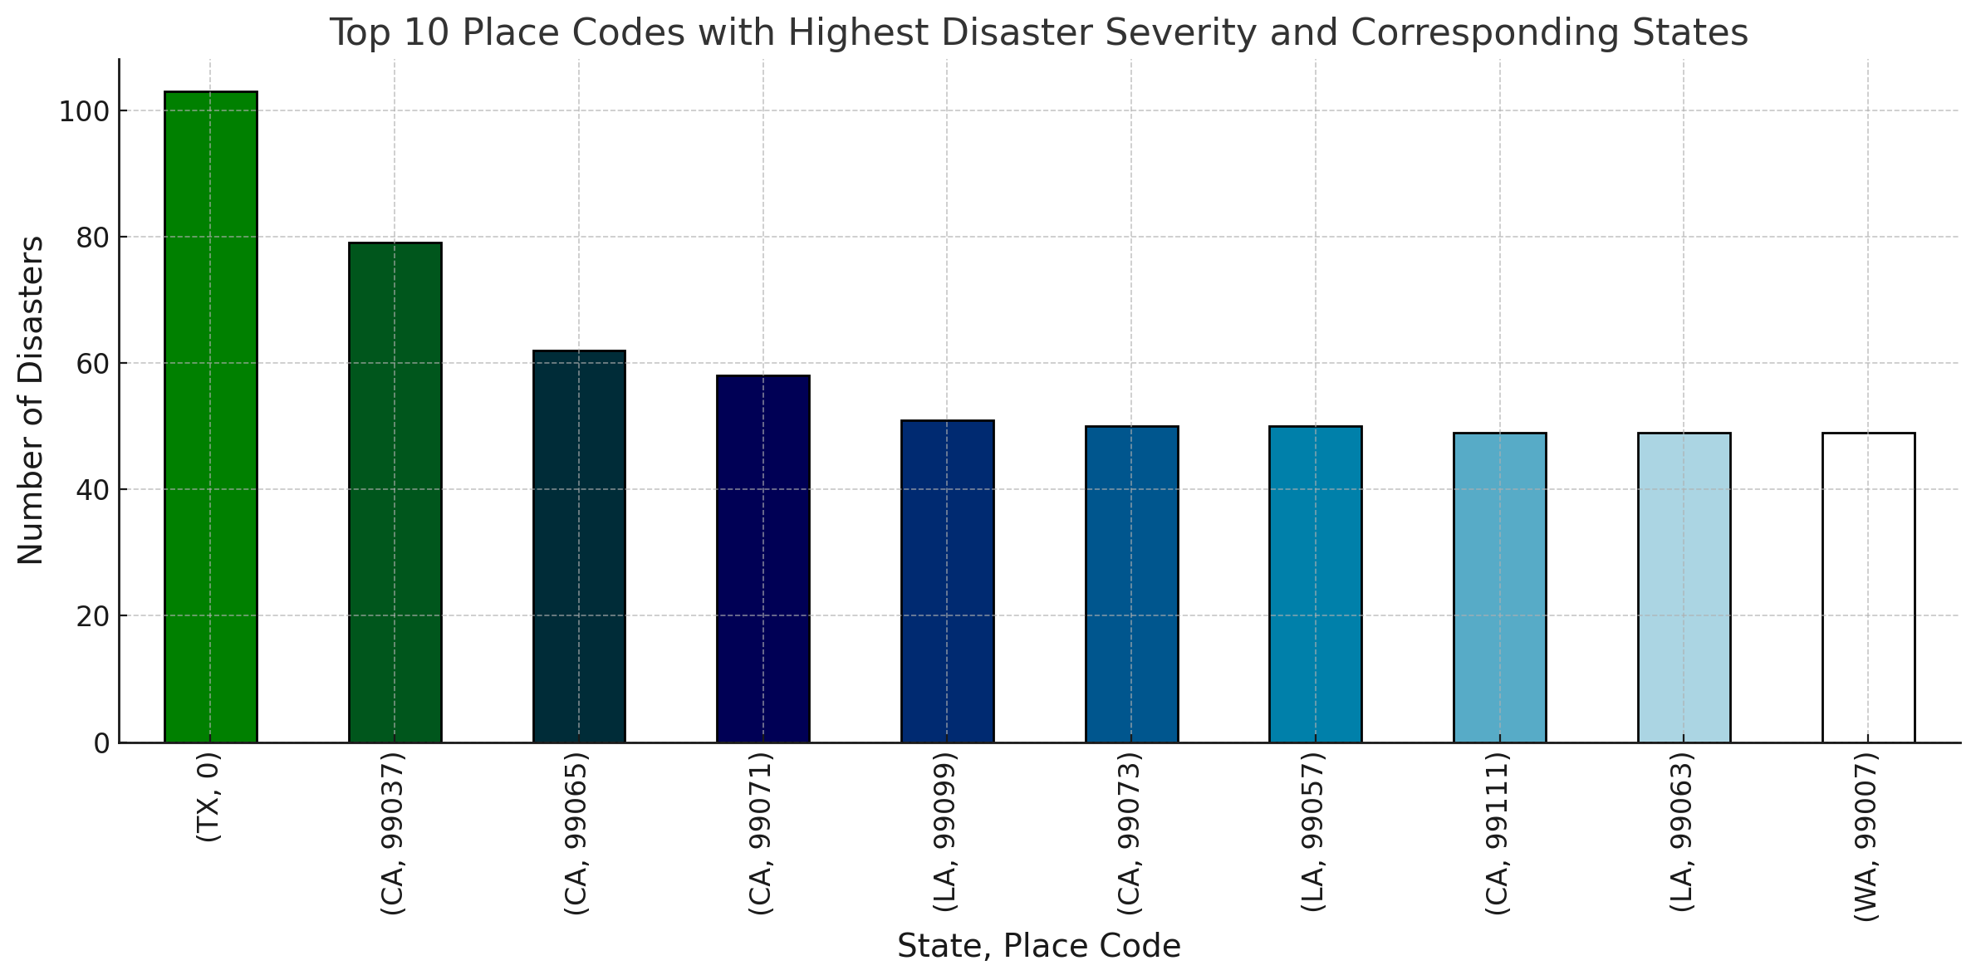
Question 04: Is there a correlation between Place_code and the frequency or severity of disaster events?
As illustrated in Fig. 6, it is evident that Texas has the highest disaster occurrences, with over 100 recorded incidents linked to specific place codes.
The place codes are organized in ranges, and all place codes falling between 0 and 99307 are associated with Texas in the dataset.
Fig.6

Slide 7
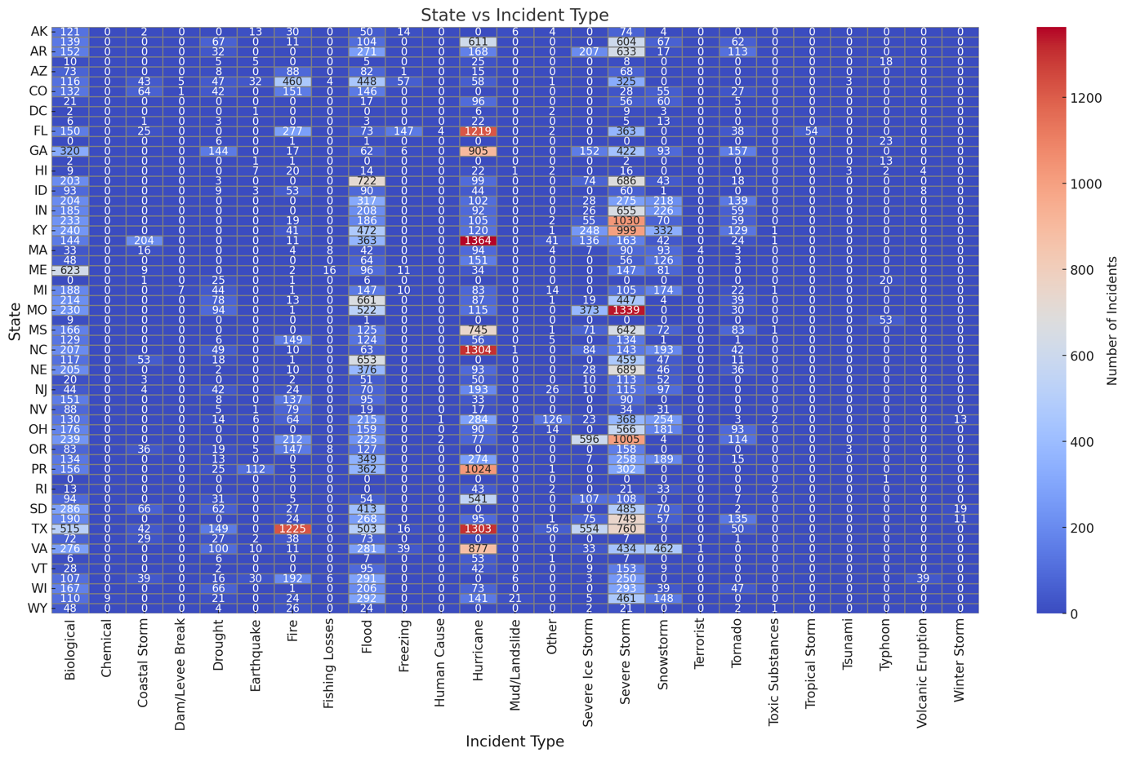
Question 05:Which states consistently have the highest counts, and what are the common disaster types there?
Fig.7
The stacked bar chart above illustrates the five most disaster-affected states with the highest number of recorded disaster events.
As shown in Fig. 7, Texas stands out as the state with the greatest number of disaster occurrences. It is also the most disaster-prone state, with an average of over 5,000 disaster events recorded over the past seven decades.
Fig.8
The theory presented is further validated by the heatmap shown in Fig. 8, which indicates that on average, Texas experiences 1,303 hurricane-related disasters, followed closely by 1,225 fire-related disasters. This heatmap visually supports the data by highlighting the frequency of these disasters in Texas.

Slide 8
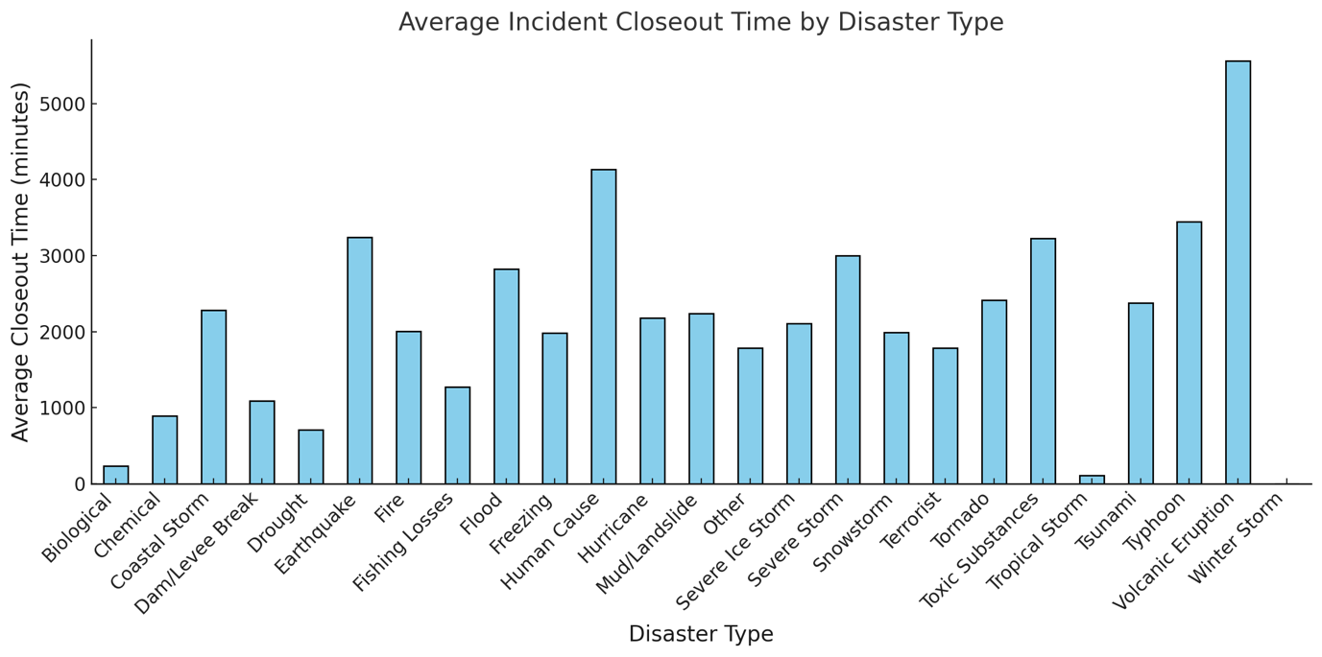
Question 06: Are certain Declaration types associated with quicker disaster closeouts?
Disasters typically occur over a span of hours to days, as illustrated in Fig. 9, where I have recorded the closeout times for various disasters that occurred over the last seven decades. From the figure, it is evident that Biological disasters have the shortest closeout times, averaging approximately 250-300 minutes.
In contrast, Volcanic Eruptions exhibit significantly longer closeout times, exceeding 5,000 minutes. This suggests that volcanic eruptions have prolonged impacts on both the environment and human populations, requiring extended recovery periods.
Fig.9

Slide 9
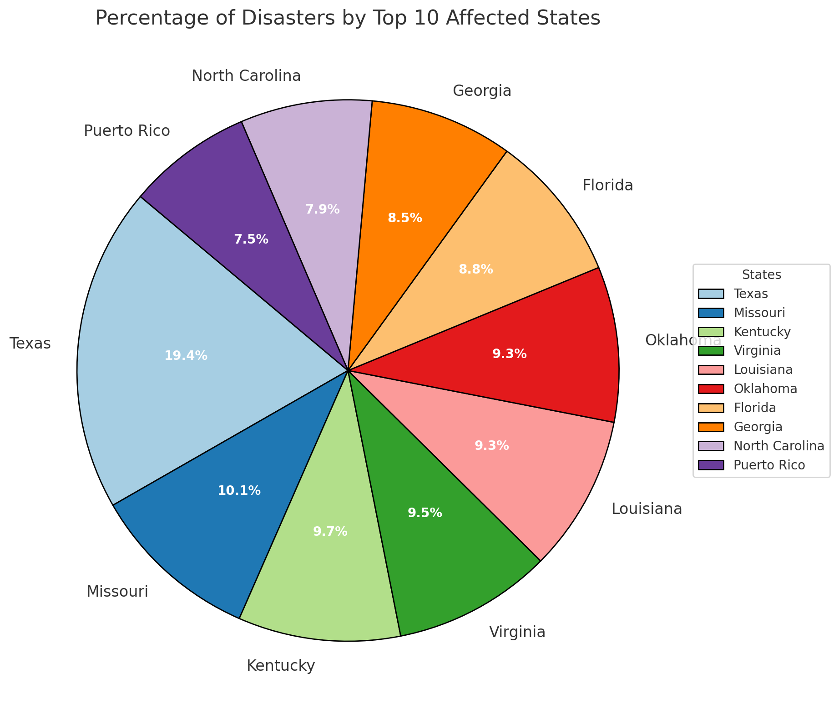
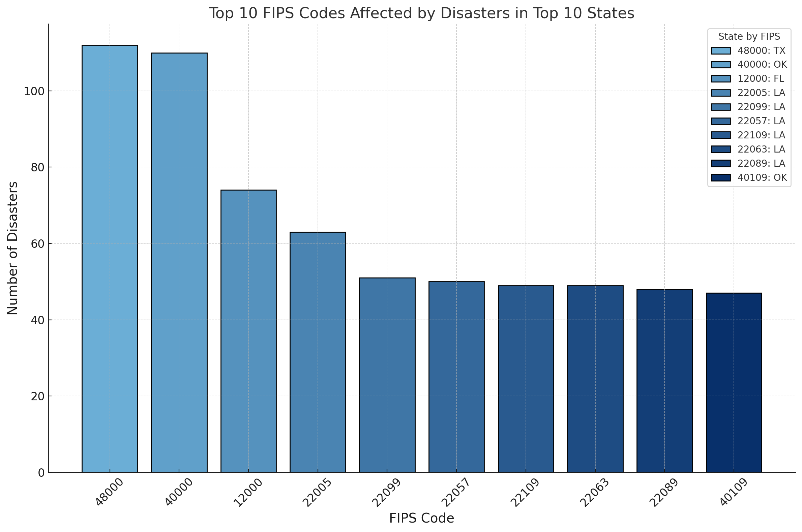
Question 07:How are disaster occurrences distributed geographically based on Fips codes?
Fig.10
Fig.11
Based on the earlier analysis, it is evident that Texas is the most disaster-affected state among all others. This conclusion is further supported by the FIPS code analysis presented in Fig. 11, which shows that on average, more than 100 disasters occurred in Texas alone. Additionally, Fig. 10 illustrates that 19.4% of all disasters recorded in the dataset took place in Texas, reinforcing its prominence in disaster occurrences.

Slide 10
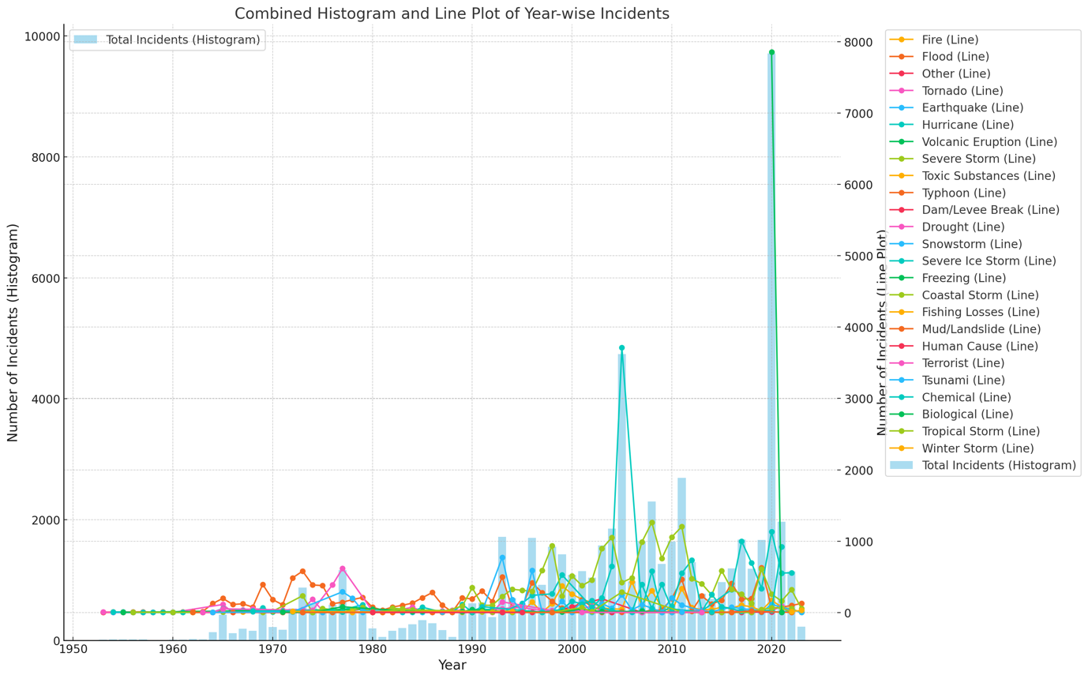
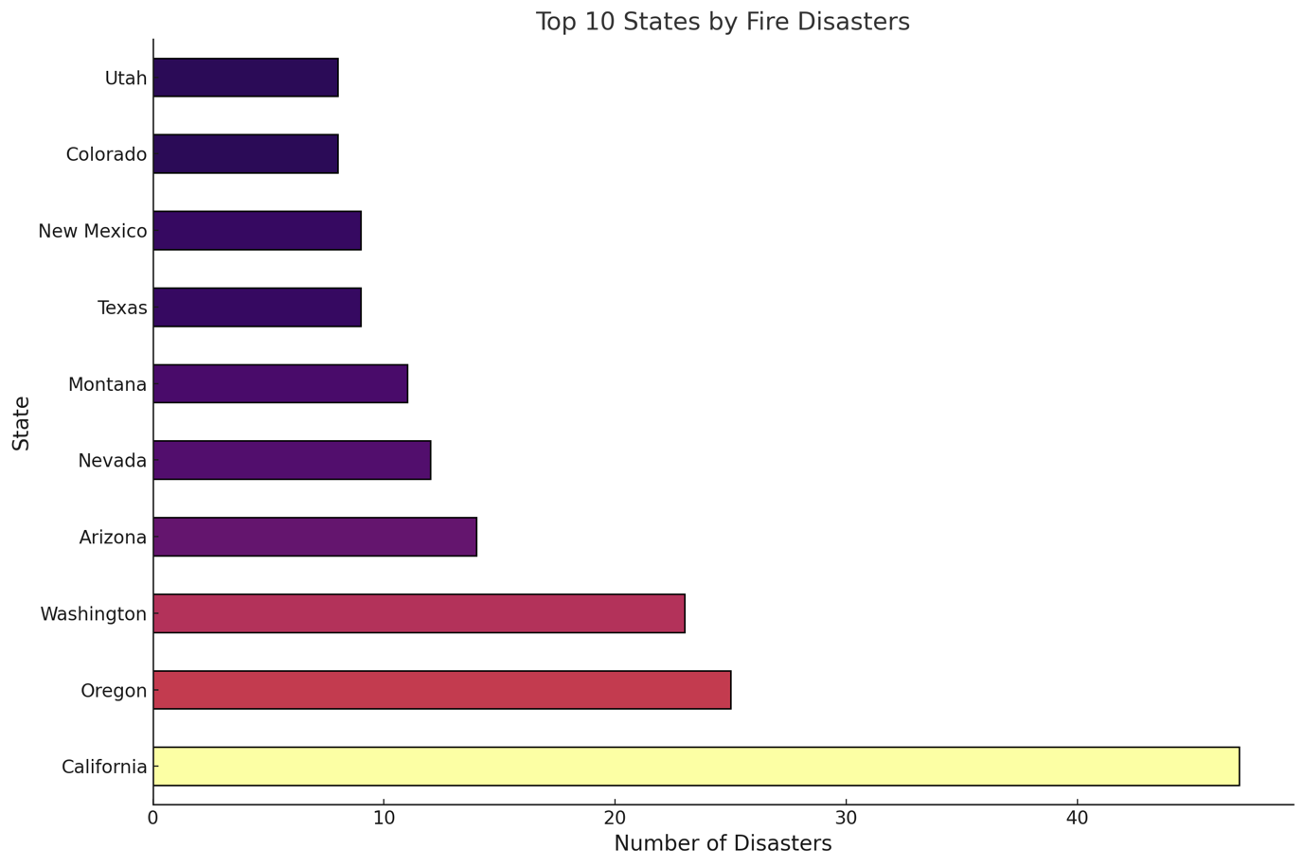
Question 08: Using historical data, can the Incident_Begin_date and Geo_Id predict the likelihood of a specific Disaster_Type in a region?
In Fig. 12, we observe that Fire-related disasters are the most prevalent disaster type, constituting over 9,000 of the total disasters recorded in the United States.
Further analysis in Fig. 13 illustrates the geographic distribution of states affected by fire disasters. California stands out as the state most impacted by fire-related events, with nearly 47 fire-related disasters occurring in the past two years alone.
Given this data, we can infer that the likelihood of fire disasters occurring in California in the future is significantly higher compared to other states.
Fig.12
Fig.13

Slide 11
Thank You!

